Slide 1
Femtoscopy studies of nucleon-hyperon potentials and $Ξ^{−}$production in 13 TeV pp collisions at ALICE
Patrick Berggold

Slide 2
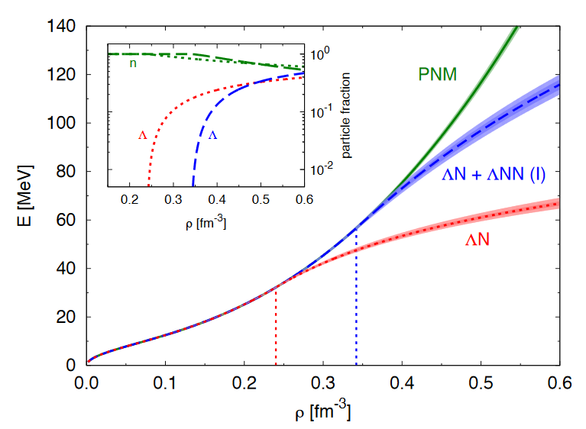
Motivation
For calculating the mass of neutron stars The Equation of State (EoS, e.g. P vs. ρ)
Inner layers and core are unknown Many interactions are possible
EoS is poorly constrained from observations, also many interactions are not well established
Inclusion of hyperons (e.g. Λ, $Ξ^{−}$):
“Softer” EoS, decrease of the energy
ρ0 2ρ0 3ρ0
Phys.Rev.Lett. 114 (2015) no.9, 092301

Slide 3
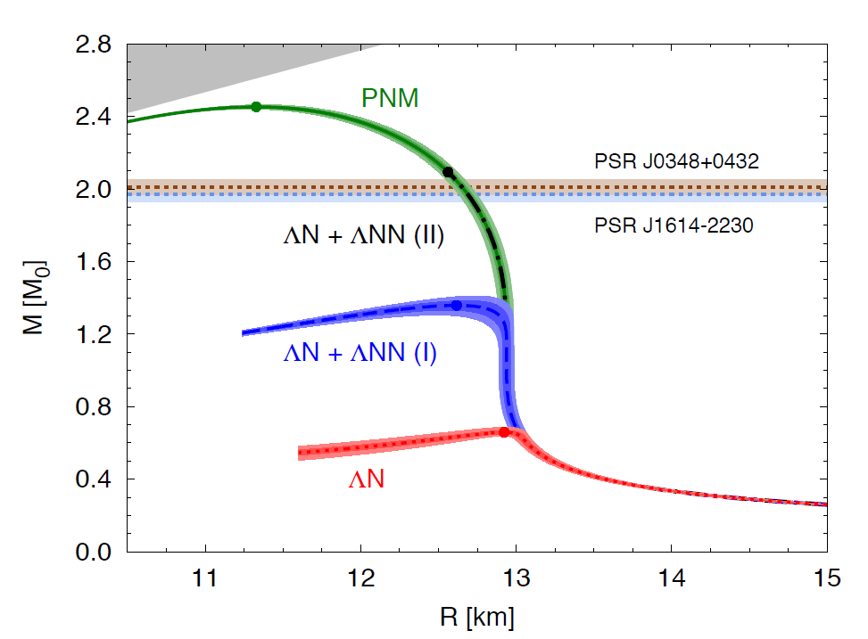
Motivation
Theoretically: Maximum mass decreases below two solar masses
Experimentally: Up to two solar masses have been observed
Experiment ≠ Theory, also called the “Hyperon Puzzle”
We need a better understanding of n-Y interactions
In this thesis:
Further investigation of the pΛ interaction via femtoscopy
$Ξ^{−}$ production analysis as basis for femtoscopy analysis
Phys.Rev.Lett. 114 (2015) no.9, 092301

Slide 4
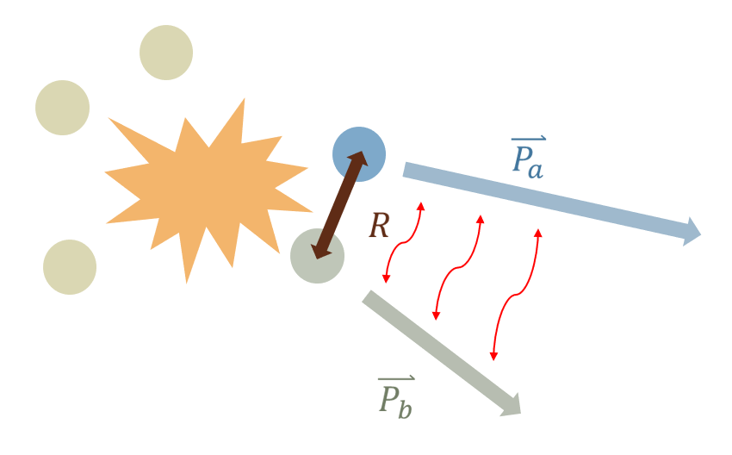
Femtoscopy
Theoretical: $C_{theo}\left(k\right)=\int{S(\overset{⃑}{r},k)∙|Ψ(\overset{⃑}{r},k)|²d\overset{⃑}{r}}$
Experimental data: $C_{exp}\left(k\right)=𝒩\frac{N_{k}(same event)}{N_{k}(mixed event)}$
$\lim_{k→∞}{C(k)}→1$ (no interaction is assumed)
Due to experimental disturbances:
In the CMS: $$k=\frac{1}{2}|{\overset{⃑}{p}}_{a}−{\overset{⃑}{p}}_{b}|$$
Λ
Source size:
≈1 fm in pp, corresponds to range of strong interaction
Interactions:
Strong interaction
Coulomb
Quantum statistics
$$S(\overset{⃑}{r},k)$$
p
$$Ψ(\overset{⃑}{r},k)$$
$$C_{fit}\left(k\right)=𝒩(λ_{theo}C_{theo}\left(k\right)+(1−λ_{theo}))$$
From MC simulations,
contribution of the primaries’ $C(k)$
arXiv:1805.12455
(Run 1)

Slide 5
pΛ potential analysis

Slide 6
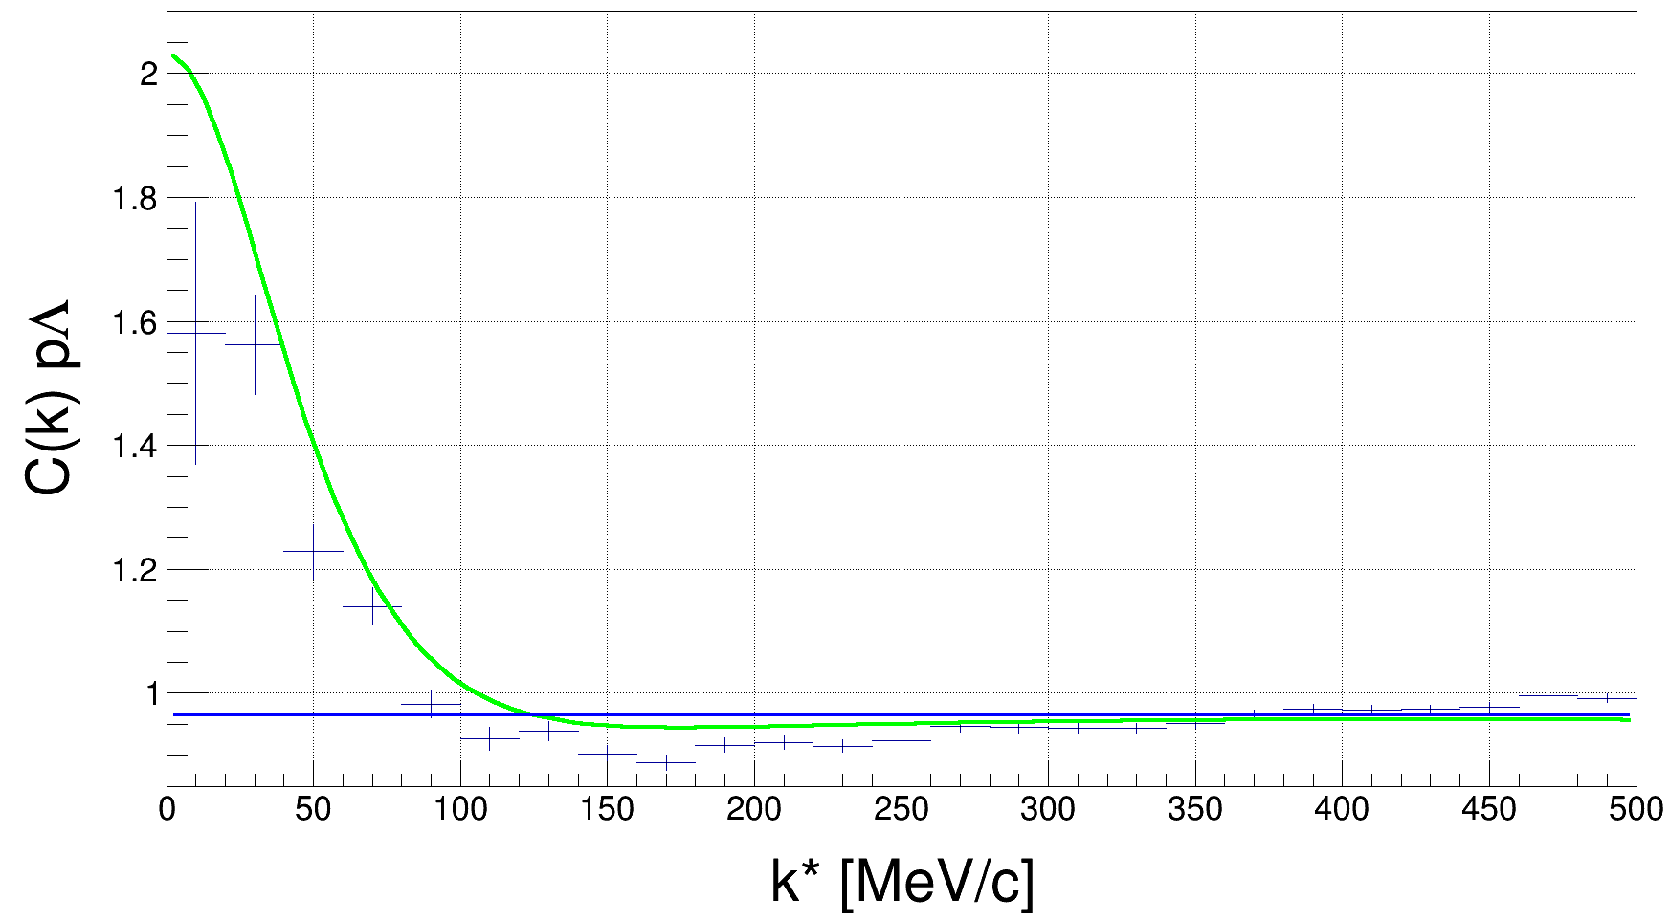
pΛ potential variations
pΛ correlation function, pp 7 TeV:
$$C_{exp}\left(k\right)=𝒩\frac{N_{k}(same event)}{N_{k}(mixed event)}$$
vs.
$$C_{fit}\left(k\right)=𝒩\left(λ_{theo}C_{theo}\left(k\right)+\left(1−λ_{theo}\right)\right)$$
$λ_{theo}$=0.47, R = 1.14 fm
For the pΛ interaction:
Usmani potential $V_{Us}$

Slide 7
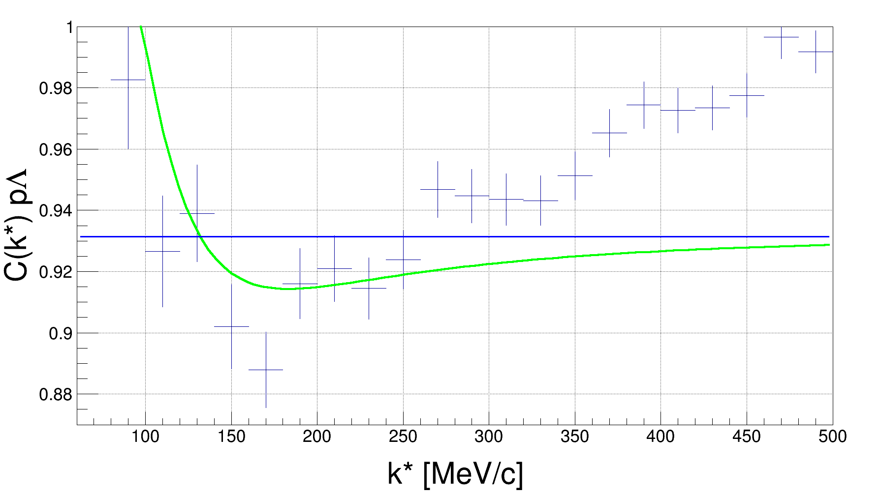
pΛ potential variations
pΛ correlation function:
$$C_{exp}\left(k\right)=𝒩\frac{N_{k}(same event)}{N_{k}(mixed event)}$$
vs.
$$C_{fit}\left(k\right)=𝒩\left(λ_{theo}C_{theo}\left(k\right)+\left(1−λ_{theo}\right)\right)$$
$λ_{theo}$=0.47, R = 1.14 fm
For the pΛ interaction:
Usmani potential $V_{Us}$
No linear slope, no dip!

Slide 8
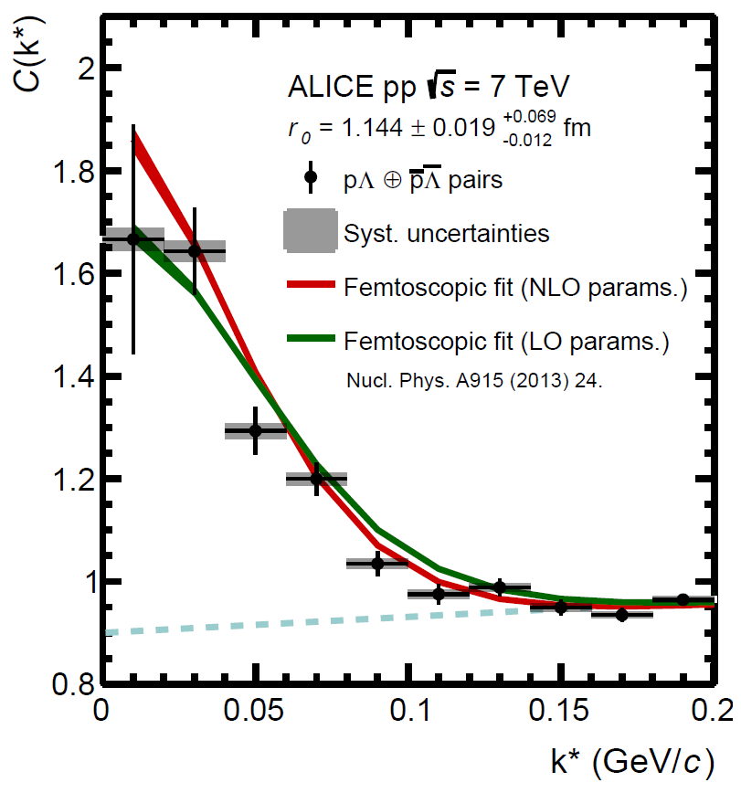
pΛ potential variations
pΛ correlation function:
$$C_{exp}\left(k\right)=𝒩\frac{N_{k}(same event)}{N_{k}(mixed event)}$$
vs.
$$C_{fit}\left(k\right)=𝒩\left(λ_{theo}C_{theo}\left(k\right)+\left(1−λ_{theo}\right)\right)$$
$λ_{theo}$=0.47, R = 1.14 fm
For the pΛ interaction:
Usmani potential $V_{Us}$
arXiv:1805.12455 (Run 1)
No linear slope, no dip!

Slide 9
pΛ potential variations
pΛ correlation function:
$$C_{exp}\left(k\right)=𝒩\frac{N_{k}(same event)}{N_{k}(mixed event)}$$
vs.
$$C_{fit}\left(k\right)=𝒩\left(λ_{theo}C_{theo}\left(k\right)+\left(1−λ_{theo}\right)\right)$$
$λ_{theo}$=0.47, R = 1.14 fm
For the pΛ interaction:
Usmani potential $V_{Us}$
No linear slope, no dip!

Slide 10
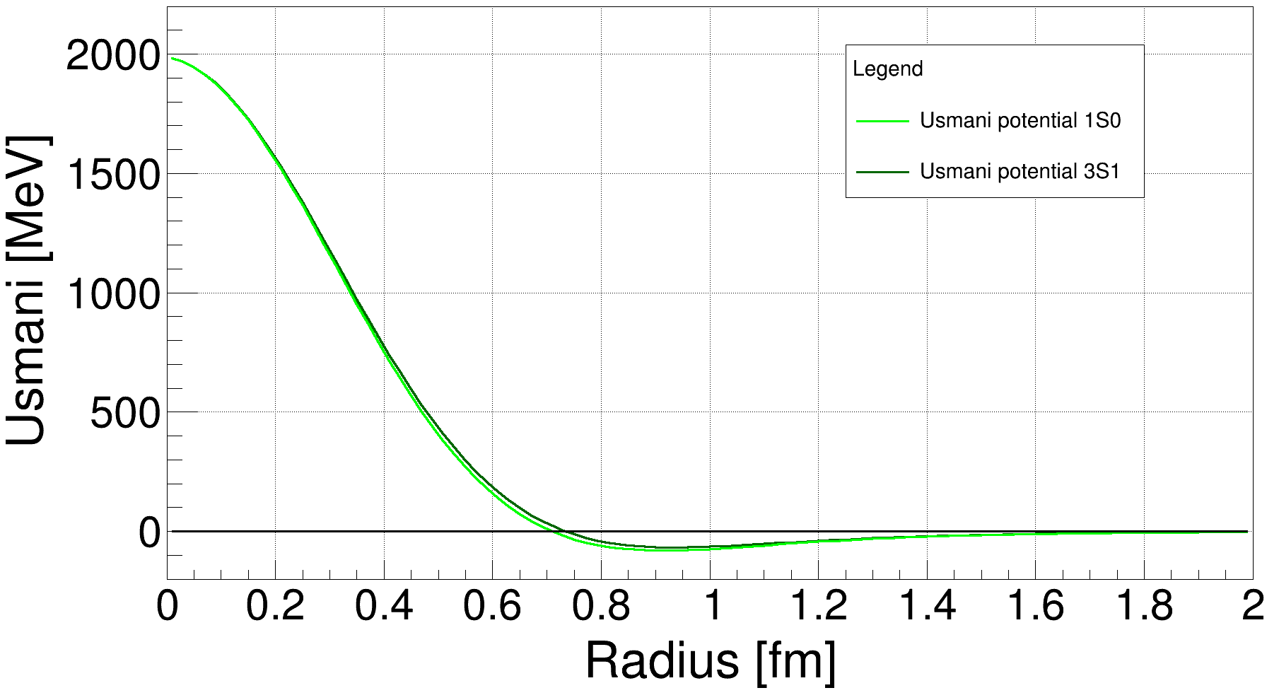
pΛ potential variations
The Usmani potential (pΛ interaction-scattering experiments):
Spin-interaction and OPE
$$V_{Usmani}=V_{C}−\left(\overline{V}−{\frac{1}{4}}V_{σ} {\overset{⃑}{σ}}_{Λ}∙{\overset{⃑}{σ}}_{p}\right)T_{π}^{2}$$
$$V_{C}(r)=W_{C}{\left(1+{exp \frac{r−R}{d⁡}}\right)}^{−1}$$
$$W_{C}=2137 MeV$$
$$R=0.5 fm$$
$$d=0.2 fm$$
Phys.Rev. C31 (1985) 1400-1411
Repulsive core $(V_{C})$ is just an effective parametrization

Slide 11
pΛ potential variations
Task:
The fit has a different shape than the data
Is this an effect of the repulsive core?

Slide 12
pΛ potential variations
Task:
The fit has a different shape than the data
Is this an effect of the repulsive core?
Identification of the Usmani potential through its scattering parameters:
 | $$a$$ | $$r_{eff}$$
1S0: | $−2.88 fm$ | $$+2.94 fm$$
3S1: | $−1.66 fm$ | $$+3.78 fm$$
$a$ – scattering length $r_{eff}$ – effective range

Slide 13
pΛ potential variations
Task:
The fit has a different shape than the data
Is this an effect of the repulsive core?
$$V_{Usmani}=V_{C}−\left(\overline{V}−{\frac{1}{4}}V_{σ} {\overset{⃑}{σ}}_{Λ}∙{\overset{⃑}{σ}}_{p}\right)T_{π}^{2}$$
$$V_{C}(r)=W_{C}{\left(1+{exp \frac{r−R}{d⁡}}\right)}^{−1}$$
$$W_{C}=2137 MeV$$
Identification of the Usmani potential through its scattering parameters:
$$R=0.5 fm$$
$$d=0.2 fm$$
 | $$a$$ | $$r_{eff}$$
1S0: | $−2.88 fm$ | $$+2.94 fm$$
3S1: | $−1.66 fm$ | $$+3.78 fm$$
Keep these scattering parameters similar!
Vary these potential parameters!
$a$ – scattering length $r_{eff}$ – effective range

Slide 14
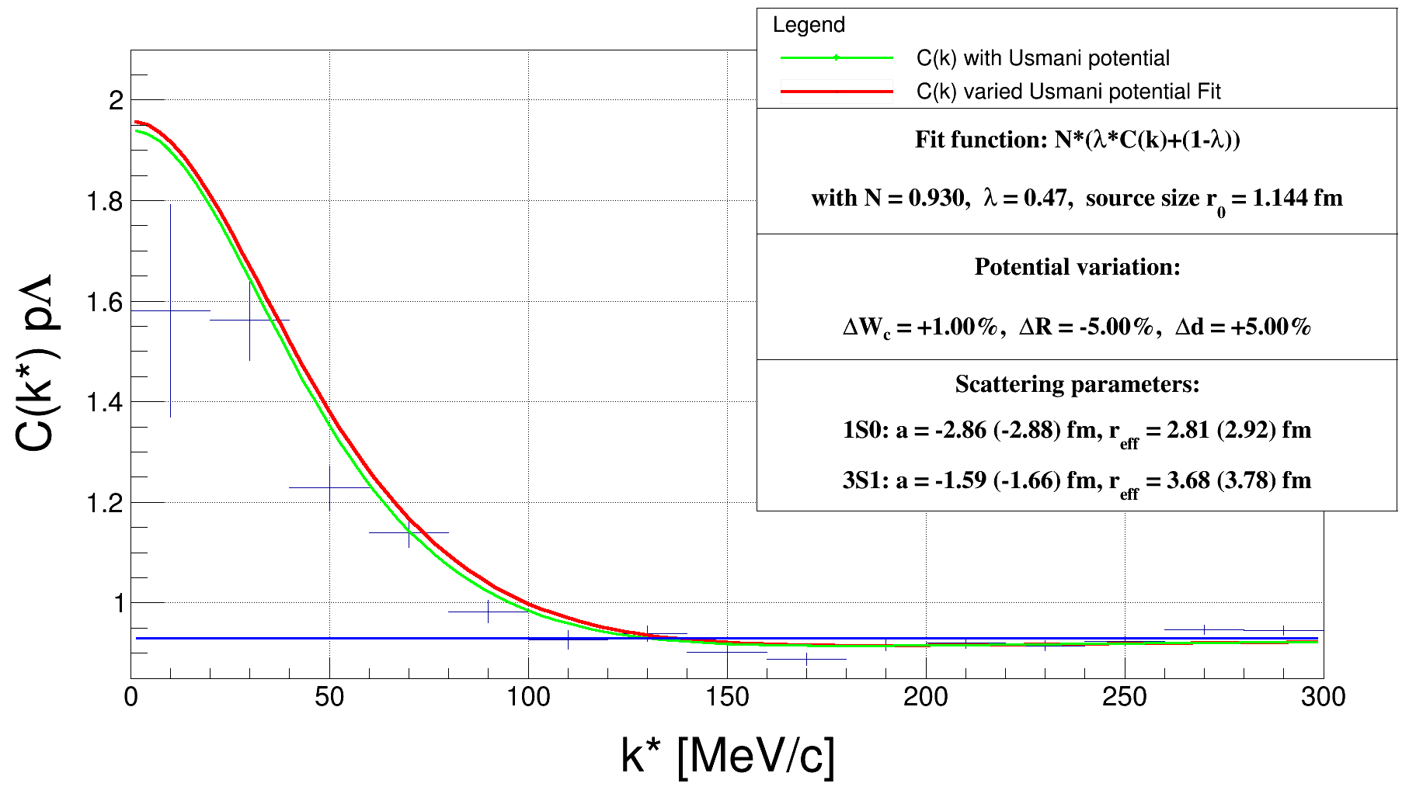
pΛ potential variations
The best result:

Slide 15
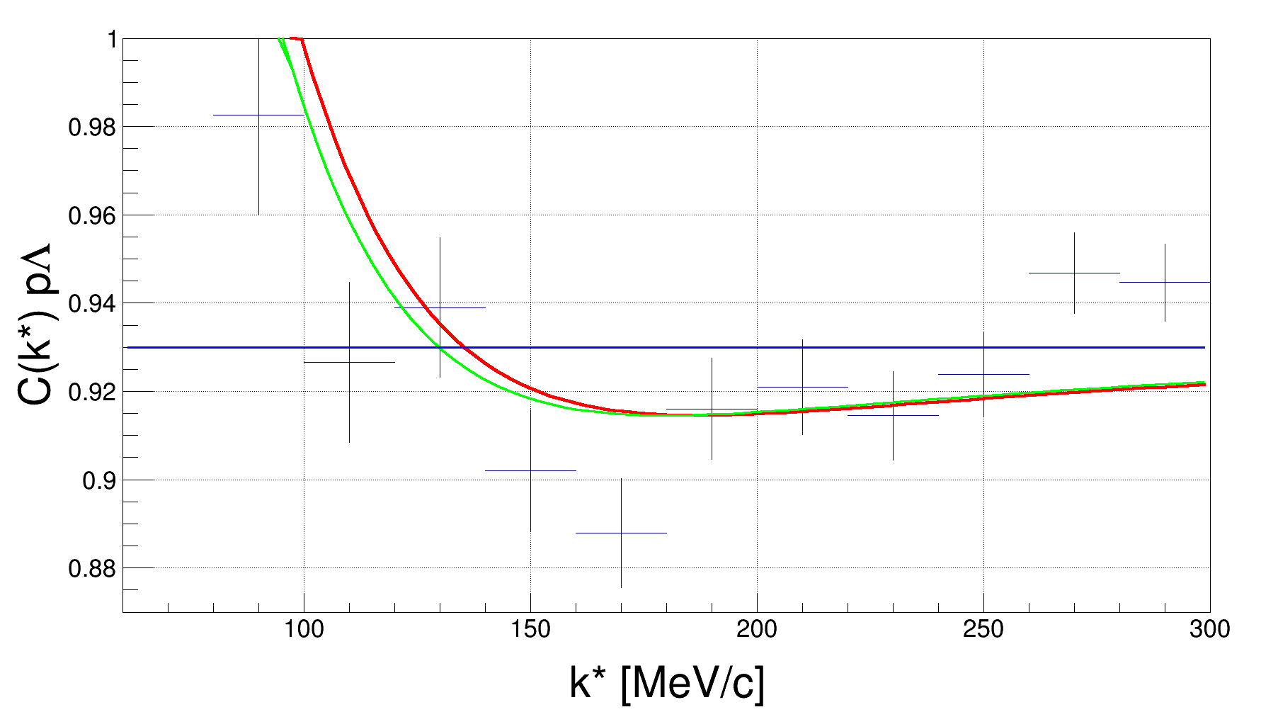
pΛ potential variations
The best result:

Slide 16
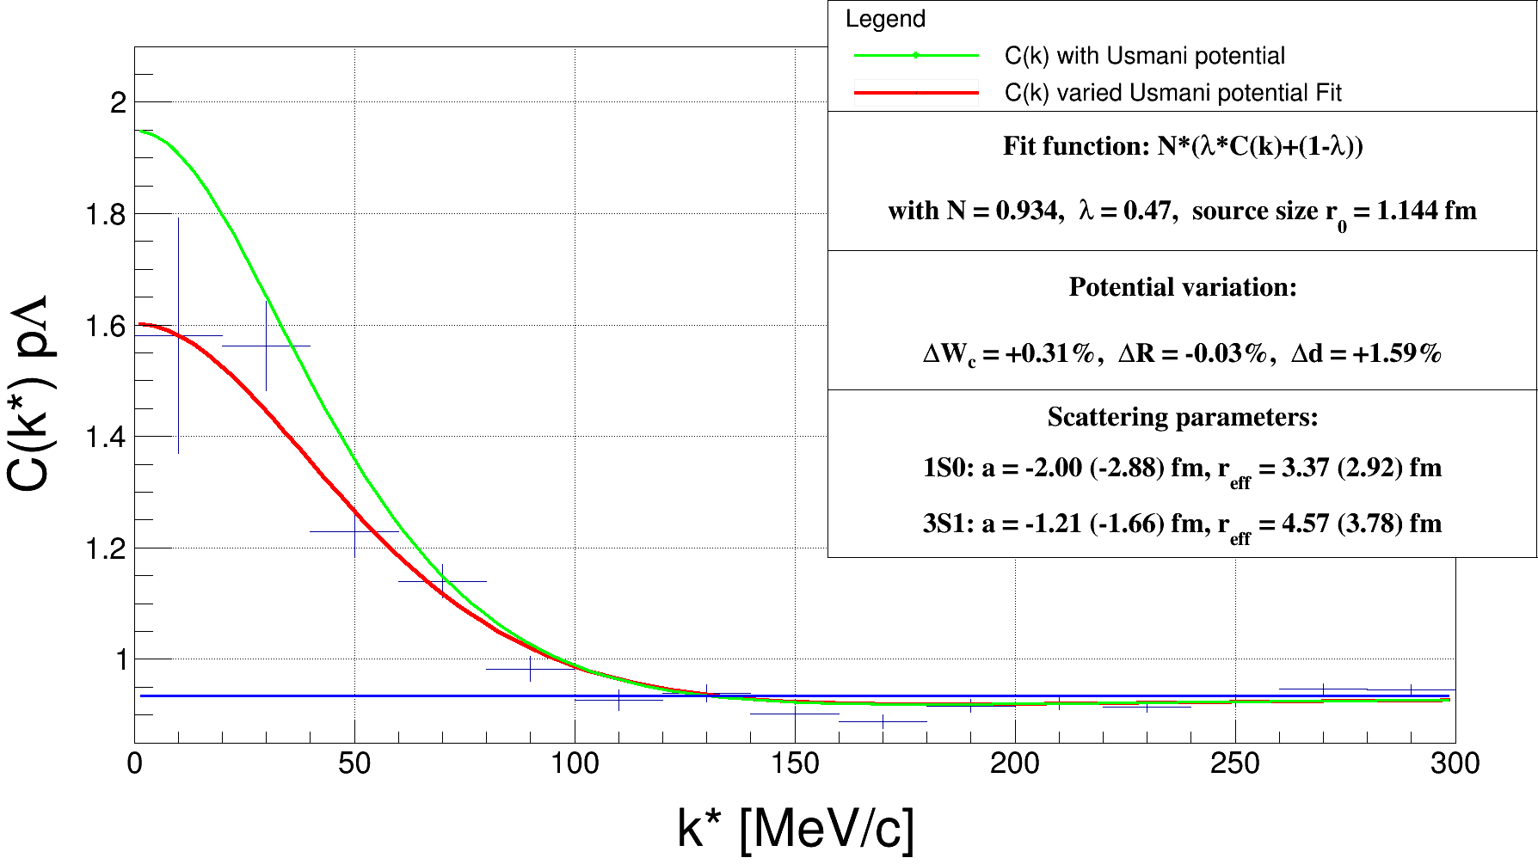
pΛ potential variations
Fit with maximum freedom:

Slide 17
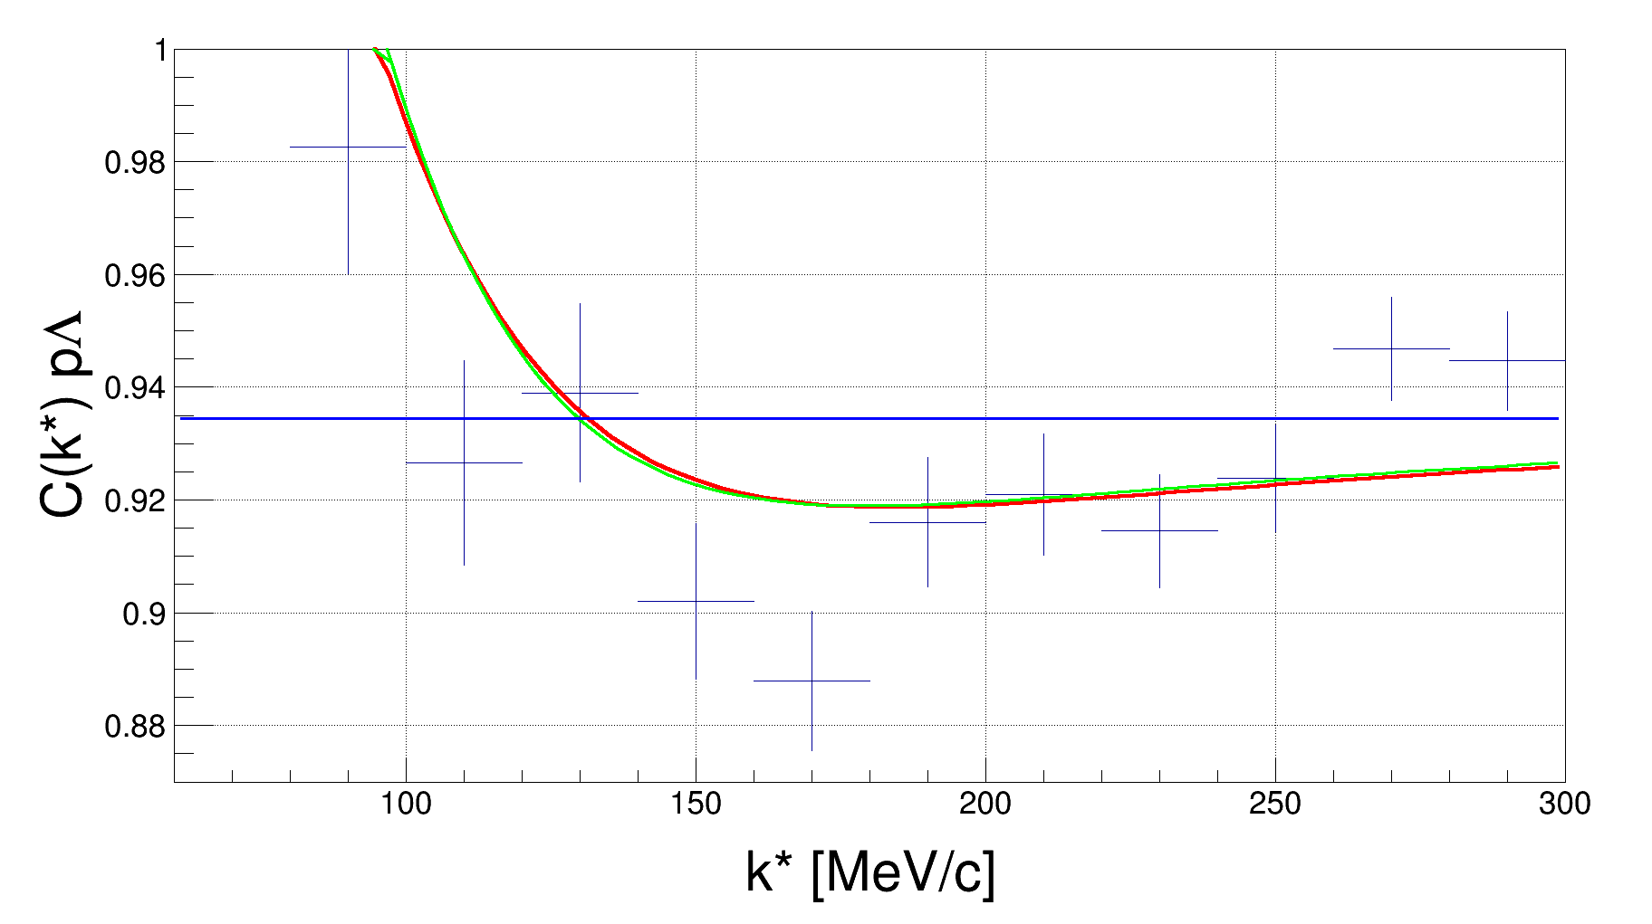
pΛ potential variations
Fit with maximum freedom:

Slide 18
pΛ potential variations
Fit with maximum freedom:
Conclusion: $V_{C}$ variations do not change the shape of $C_{fit}(k)$ for larger $k$!

Slide 19
$Ξ^{−}$ production analysis

Slide 20
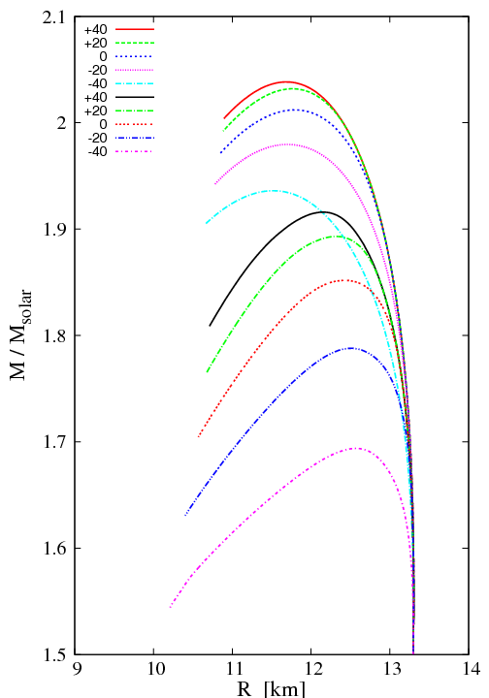
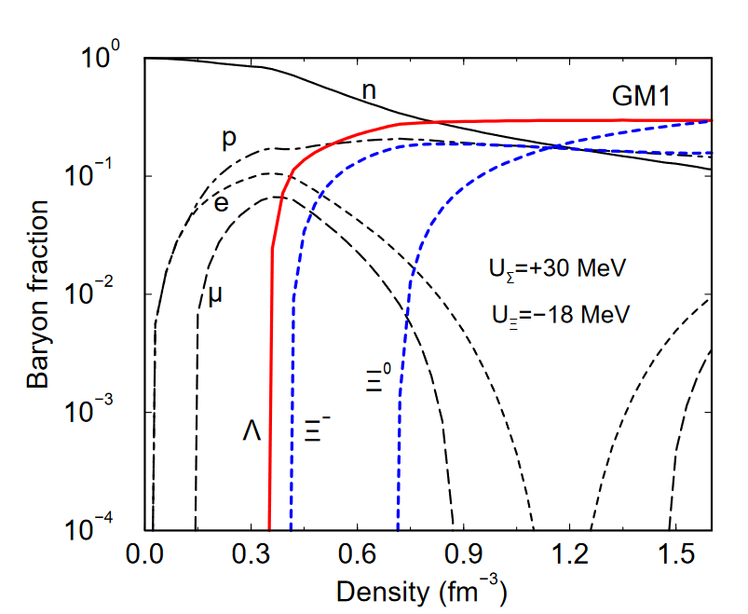
$$U_{Ξ^{−}}^{(N)}$$
$Ξ^{−}$ production analysis
With increasing nuclear density: even heavier particles can be produced, e.g. the $Ξ^{−}$
More repulsive N-$Ξ^{−}$ potential means a stiffer EoS!
ρ0 2ρ0 3ρ0 4ρ0 …..
J. Schaﬀner-Bielich, NPA 804 (2008)
Weissenborn, Chatterjee , Schaﬀner-Bielich,
NPA 881 (2012)

Slide 21
$Ξ^{−}$ production analysis
Measuring the n-$Ξ^{−}$ correlation is difficult: Unaccessible!
Study the n-$Ξ^{−}$ correlation indirectly through lattice QCD and p-$Ξ^{−}$ (enough statistics)

Slide 22
$Ξ^{−}$ production analysis
Measuring the n-$Ξ^{−}$ correlation is difficult: Unaccessible!
Study the n-$Ξ^{−}$ correlation indirectly through lattice QCD and p-$Ξ^{−}$ (enough statistics)
Lattice QCD | I=0 | I=1
S=0 | $${−58.4}_{−1.0}^{+3.4} MeV$$ | $${+12.4}_{−2.9}^{+3.8} MeV$$
S=1 | $${−22.7}_{−5.7}^{+4.5} MeV$$ | $${−9.7}_{−1.1}^{+3.0} MeV$$
I=1: n-$Ξ^{−}$, p-$Ξ^{0}$ : ${−4}_{−1.23}^{+1.71}$ MeV
I=0,1: p-$Ξ^{−}$, n-$Ξ^{0}$ : ${−17.15}_{−2.05}^{+1.9}$ MeV

Slide 23
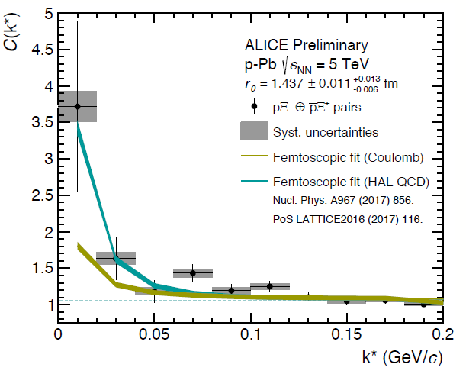
$Ξ^{−}$ production analysis
Measuring the n-$Ξ^{−}$ correlation is difficult: Unaccessible!
Study the n-$Ξ^{−}$ correlation indirectly through lattice QCD and p-$Ξ^{−}$ (enough statistics)
pPb – collisions from preliminaries:
Lattice QCD | I=0 | I=1
S=0 | $${−58.4}_{−1.0}^{+3.4} MeV$$ | $${+12.4}_{−2.9}^{+3.8} MeV$$
S=1 | $${−22.7}_{−5.7}^{+4.5} MeV$$ | $${−9.7}_{−1.1}^{+3.0} MeV$$
I=1: n-$Ξ^{−}$, p-$Ξ^{0}$ : ${−4}_{−1.23}^{+1.71}$ MeV
I=0,1: p-$Ξ^{−}$, n-$Ξ^{0}$ : ${−17.15}_{−2.05}^{+1.9}$ MeV
Observation of attractive strong interaction

Slide 24
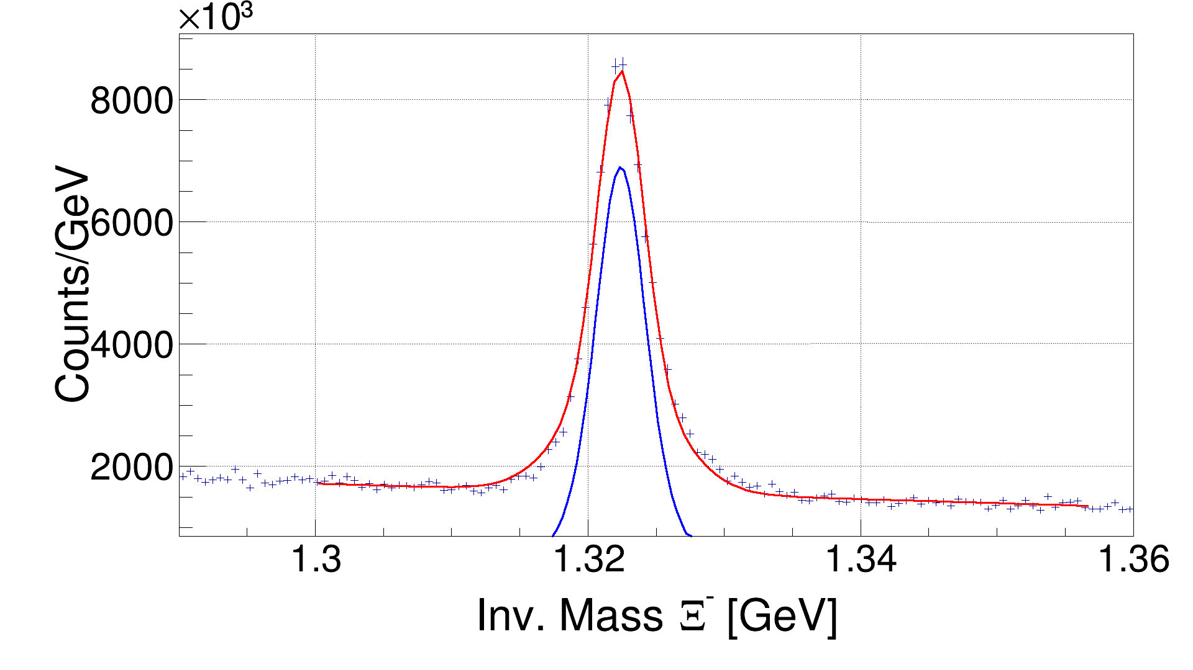
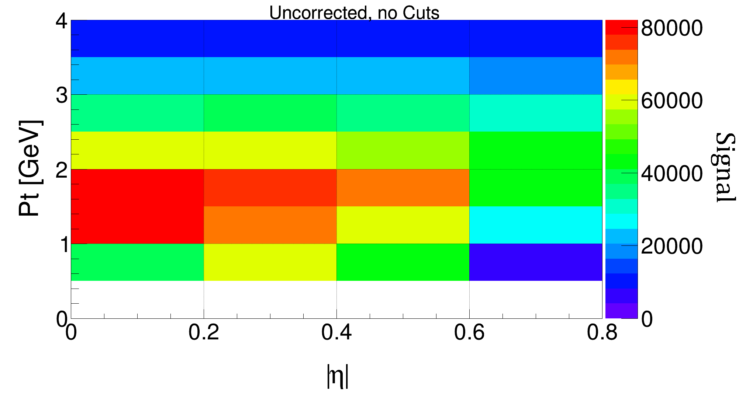
$Ξ^{−}$ production analysis
Strategy:
$Ξ^{−}$ reconstruction:
$p_{T}$: 2.0 – 2.5 GeV
|η|: 0.2- 0.4
Background
+ signal
$$Ξ^{−}→Λ^{0}+π^{−}→p+π^{−}+π^{−}$$
Signal
IM spectra within certain transverse momentum $p_{T}$ and pseudorapidity η ranges
Obtain the signal through one fit
Generate the uncorrected spectra
60% of the signal are lost due
to track selection cuts!

Slide 25
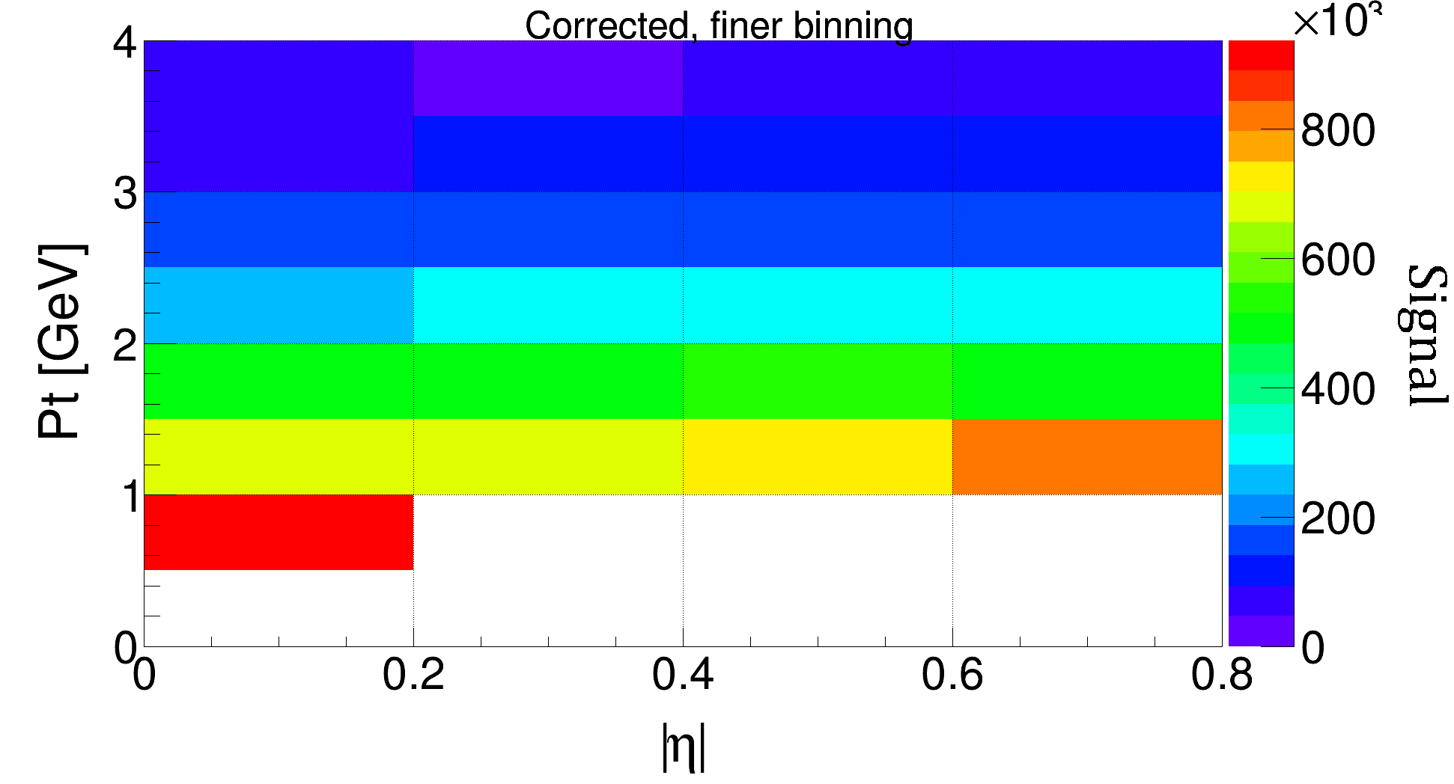
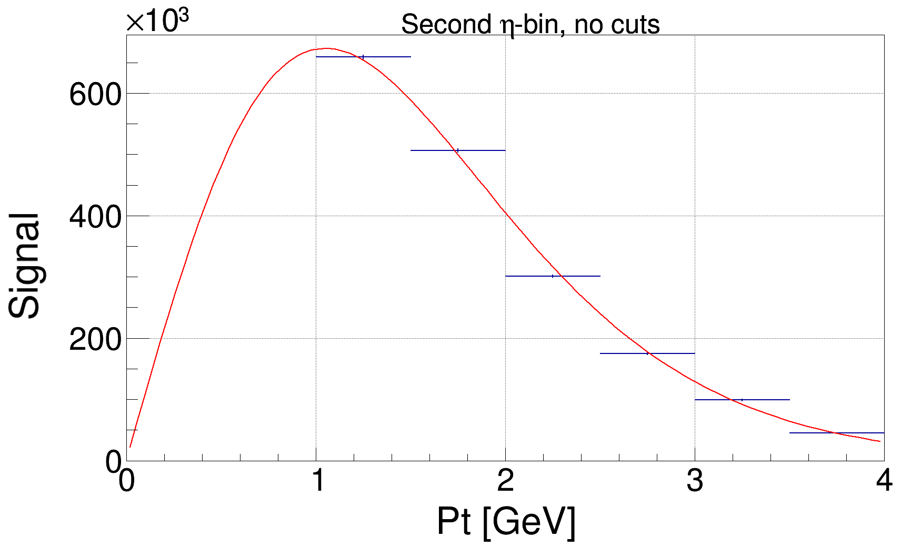
$Ξ^{−}$ production analysis
Detector effects: acceptance and efficiency corrections through true and full MC simulations $S_{source,i,j}=S_{data,i,j}∙\frac{S_{trueMC,i,j}}{S_{fullMC,i,j}}$
Apply other corrections like branching ratio or trigger efficiency corrections
Expansion into full $p_{T}$ acceptance through Boltzmann fit in every |η| bin

Slide 26
$Ξ^{−}$ production analysis
The production cross section obtained with the following formula:
$$\frac{dσ}{d|η|} =\frac{1}{ℒ}\frac{S}{Δ|η|∙ε^{branch}ε^{trig}ε^{vtx}ε^{AEM}}$$
With and without track selection cuts, we obtain over four |$η$| bins :
$$\frac{dσ}{d|η|} =\left(3.56±{(0.18)}^{stat}±{(0.25)}^{syst}\right)mb$$
Signal over all |eta|-bins
with luminosity $ℒ=\frac{N_{evt}}{ε_{evt}^{vtx}∙σ_{pp}^{V0AND}}$ , $σ_{pp}^{V0AND}=\left(57.8±2.9\right)mb$
$$_{\left|η\right|<0.8}$$
Luminosity
|$η$|-bin width
Various efficiencies
$$_{\left|η\right|<0.8}$$

Slide 27
Summary
The pΛ potential, specifically the repulsive core, was varied
Does not have an influence on the shape of the correlation function
The $Ξ^{−}$ production was investigated
The effect of track selection cuts have been analyzed
The necessary steps for generating the cross section were displayed

Slide 28
Thank you for your attention!

Slide 29
Back up

Slide 30
Introduction – density dependence $U_{Λ}$
$Λ$potential in symmetric nuclear matter
$χ$EFT NLO + 3BF
Nuclear Density
$χE$FT NLO
Nijmegen NSC97f
Jülich ’04
Euro. Phys. A53, 121 (2017)

Slide 31
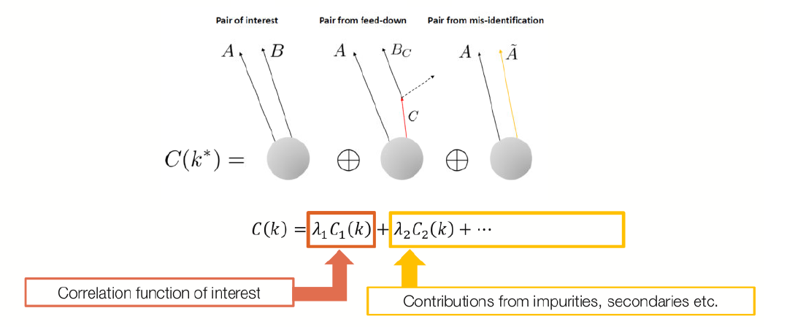
Femtoscopy – Residuals, etc.
However $C_{theo}\left(k\right)≠C_{exp}\left(k\right)$!!!
Corrections necessary due to experimental disturbances:
$C_{total}\left(k\right)=\sum_{i}{λ_{i}C_{i}\left(k\right)}$ with weights $λ_{i}$
If all disturbing correlations are flat: $C_{i≠1}\left(k\right)=1$ $C_{fit}\left(k\right)=𝒩(λ_{theo}C_{theo}\left(k\right)+(1−λ_{theo}))$

Slide 32
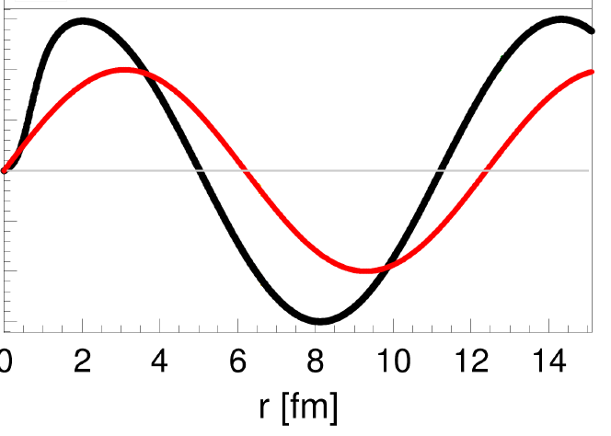
pΛ potential variations – phase shift
The Usmani scattering parameters:
$pΛ$wave function:
without potential
$$δ$$
Potential
phase shift ($δ$) of the wave function
with potential
scattering length $a$ and effective range $r_{eff}$
$$\lim_{k→0}\left(k∙\cot{δ\left(k\right)}\right) =−\frac{1}{a}+\frac{r_{eff}}{2}k^{2}$$
 | $$a$$ | $$r_{eff}$$
1S0: | $−2.88 fm$ | $$+2.94 fm$$
3S1: | $−1.66 fm$ | $$+3.78 fm$$

Slide 33
Femtoscopy
Run 1 data set:
Fitted with a linear baseline:
Linear baseline for non-femto effects
$$C_{Run 1}\left(k\right)=𝒩(a+b∙k)(λ_{theo}C_{theo}\left(k\right)+(1−λ_{theo}))$$
Linear baseline fit
$a,b$ and $𝒩$ are free fit parameters

Slide 34
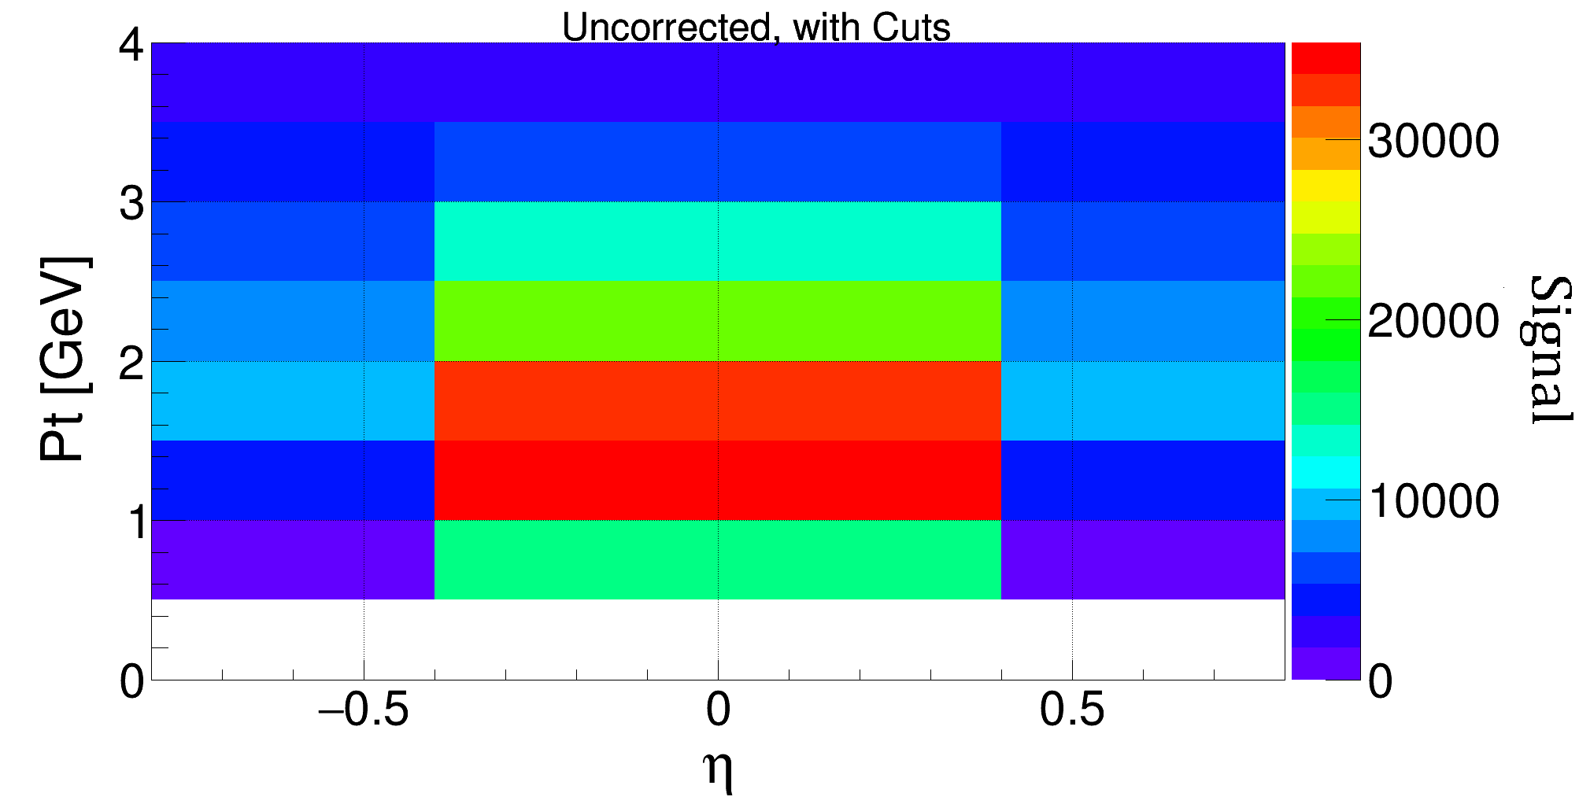
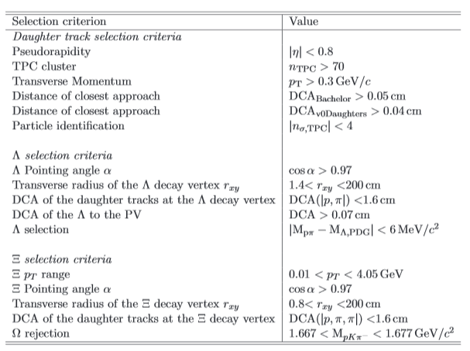
$Ξ^{−}$ production analysis – with cuts
Uncorrected spectra with track selection cuts:
Track selection cuts for the $Ξ^{−}$:

Slide 35
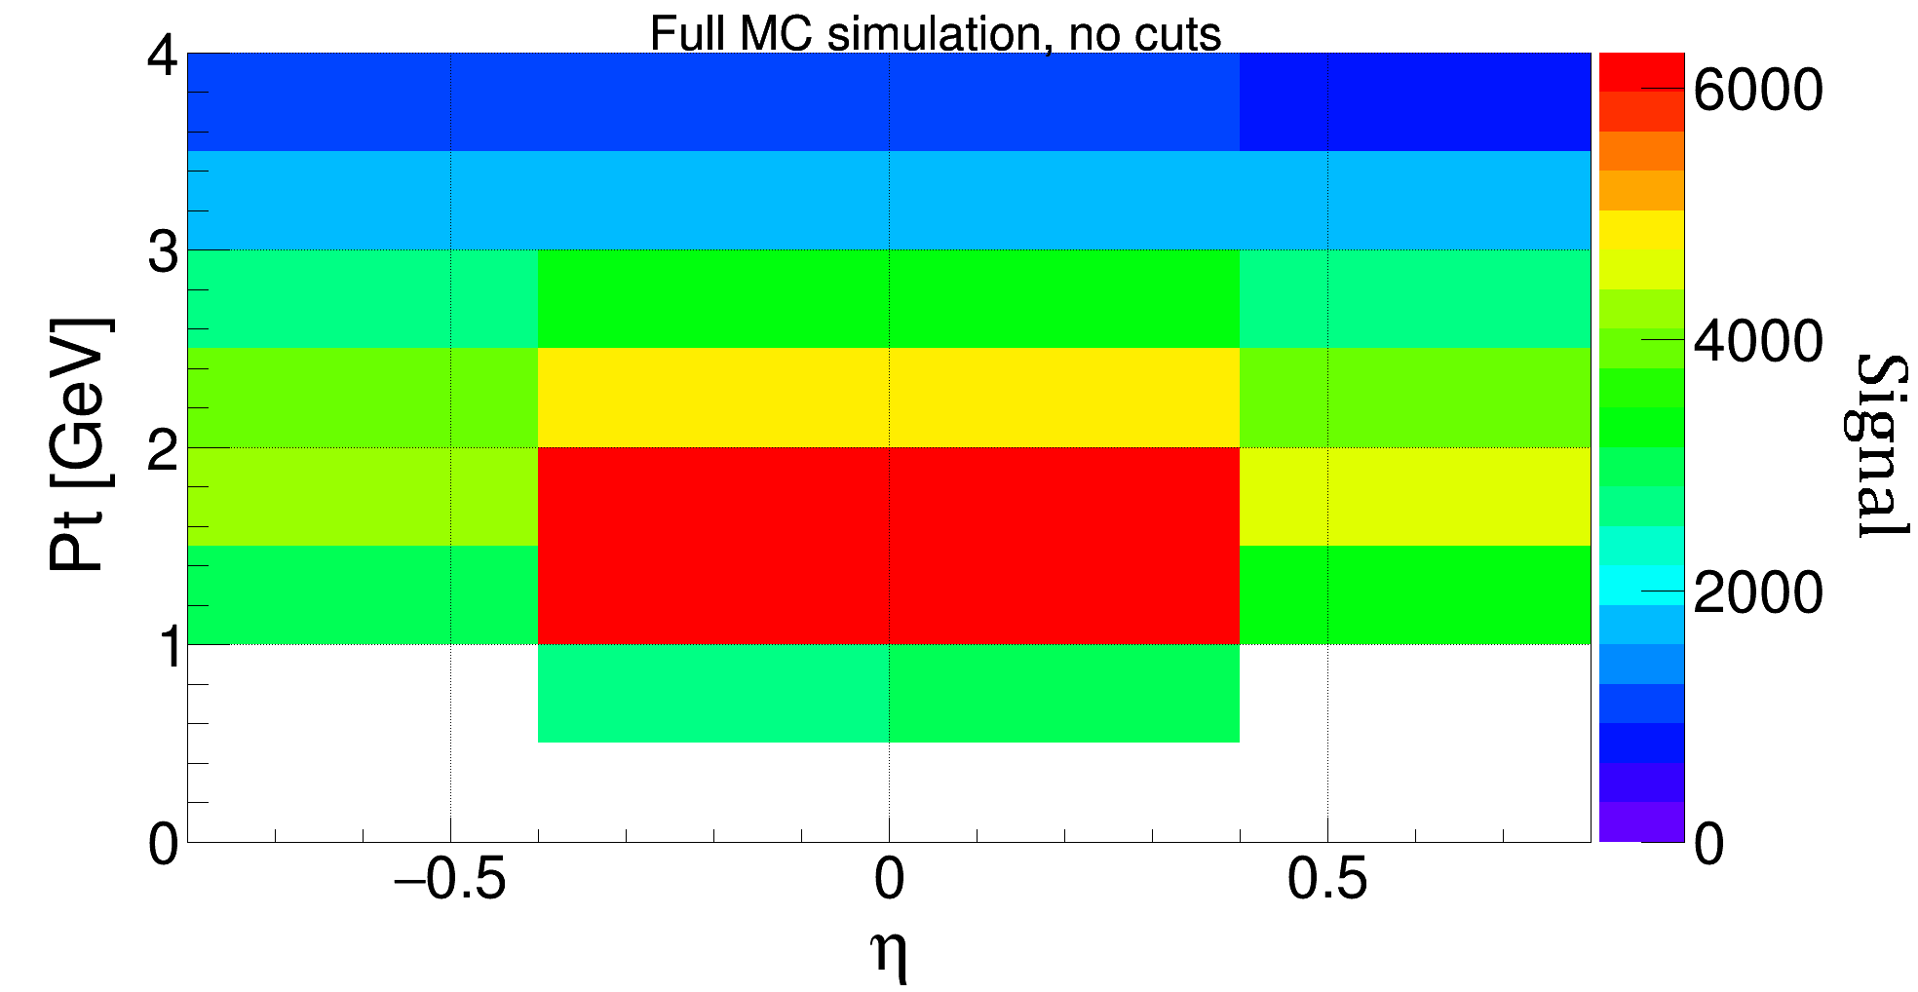
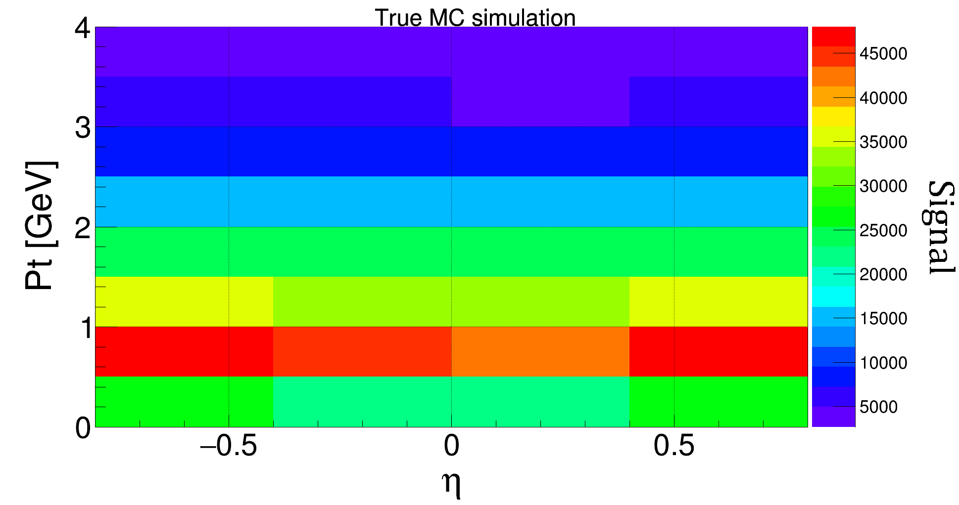
$Ξ^{−}$ production analysis – MC simulation
Full MC simulation (simulates the $Ξ^{−}$
detection and reconstruction):
True MC simulation (simulates the $Ξ^{−}$
production from the source):
$$S_{source,i,j}=S_{data,i,j}∙\frac{S_{trueMC,i,j}}{S_{fullMC,i,j}}$$

Slide 36
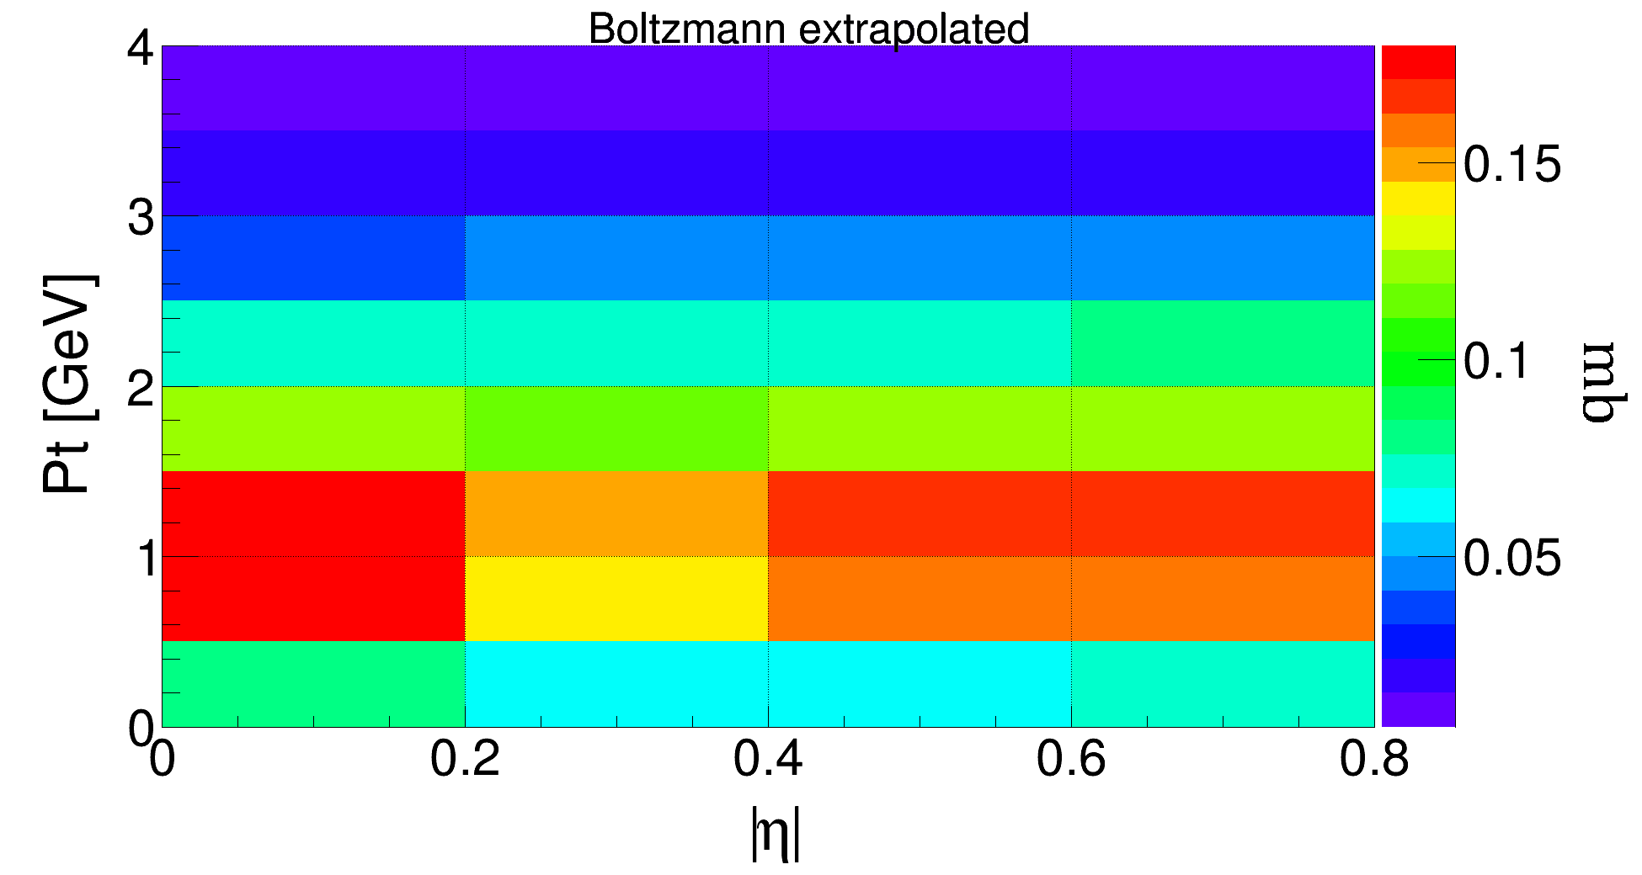
$Ξ^{−}$ production analysis – Boltzmann extrapolated
A second method for cross checking with 1 |eta|-bin and 32 |pT|-bins: $$\frac{dσ}{d|η|} =\left(3.95±0.2\right)mb$$
Boltzmann extrapolation of the corrected spectra is possible
Fill each bin with the total cross section by integrating the fit function in each bin
$$_{1x32, no cuts}$$
$$_{1x32, with cuts}$$
$$\frac{dσ}{d|η|} =\left(4.67±0.23\right)mb$$
$$_{\left|η\right|<0.8}$$
$$_{\left|η\right|<0.8}$$
Boltzmann-fit formula:
$$f\left(p_{T}\right)=𝒩∙p_{T}\sqrt{p_{T}^{2}+m^{2}}\frac{exp⁡(−\frac{\sqrt{p_{T}^{2}+m^{2}}}{T}) }{T\left(m^{2}+2mT+2T^{2}\right)exp⁡(−\frac{m}{T})}$$

